Slide 1

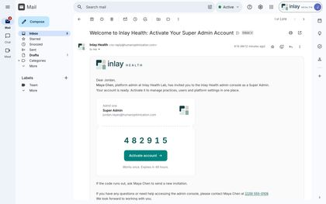
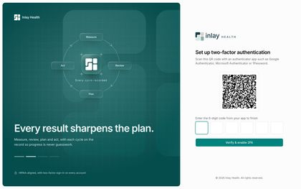
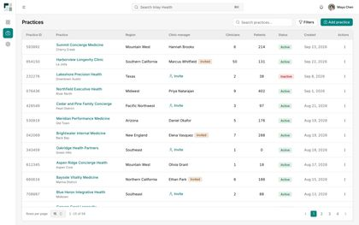
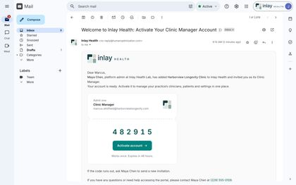
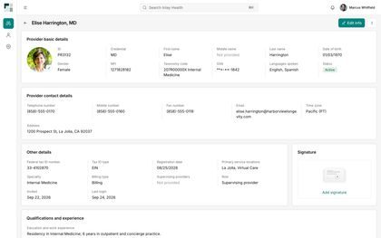
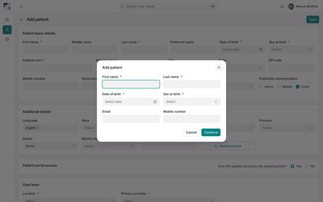
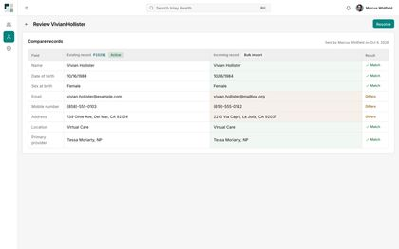
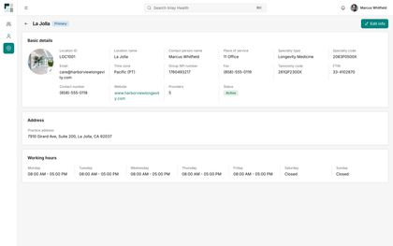
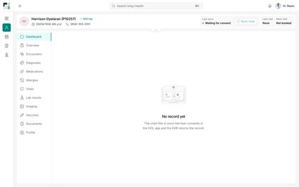
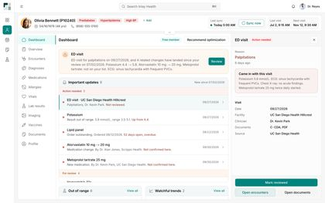
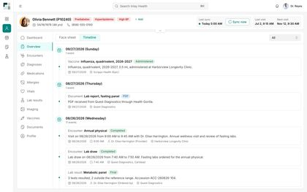
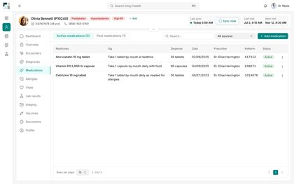
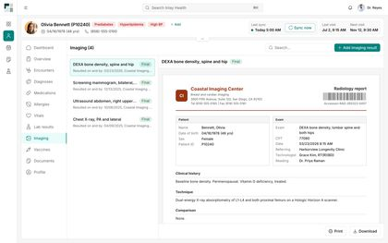
WEB PORTALS
The Care Team Portals
Thirty-eight screens across Super Admin, Clinic Manager and Provider, from the first invitation to a patient's full chart.
01 Super Admin
02 Clinic Manager
03 Provider
38 screens · 3 portals · 9 stages
Internal discussion draft · October 2026
Screens captured from the live web build

Slide 2




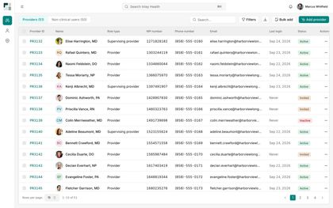
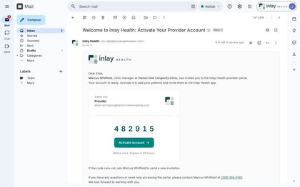
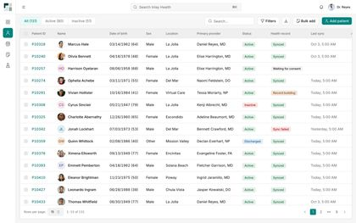
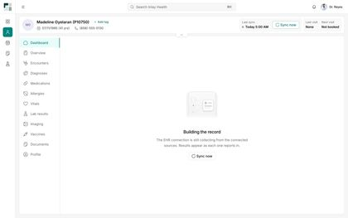
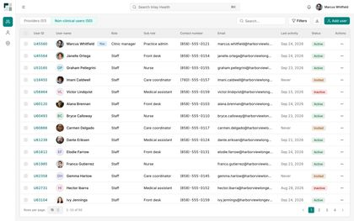
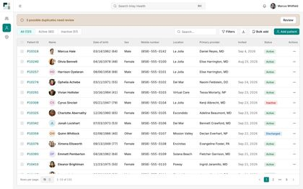
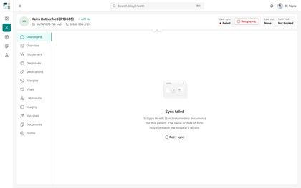
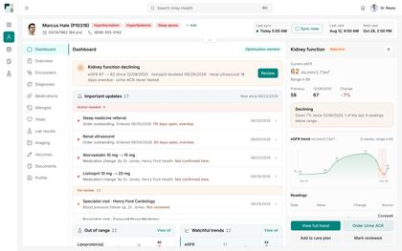
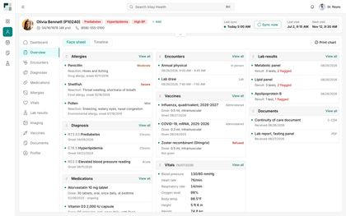
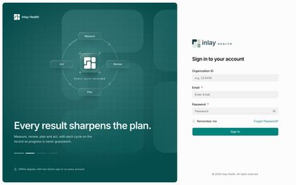

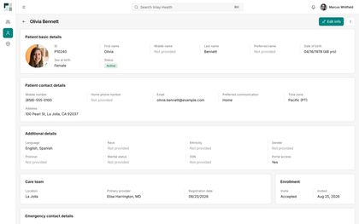
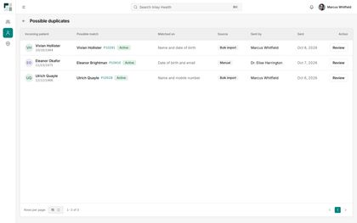
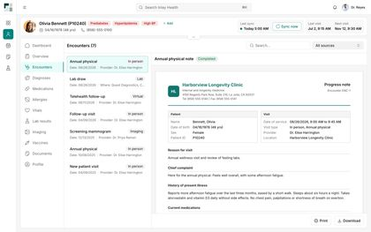
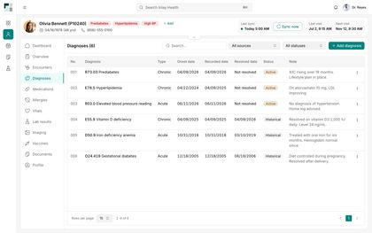
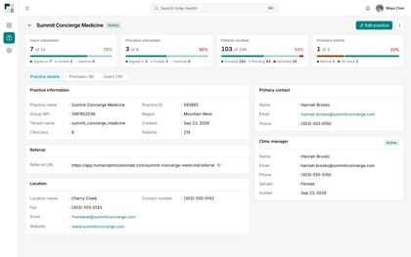
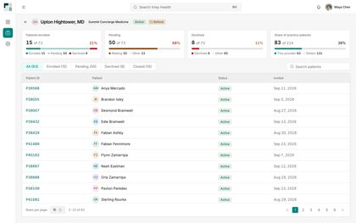
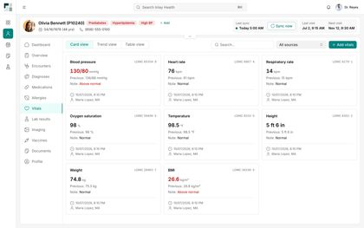
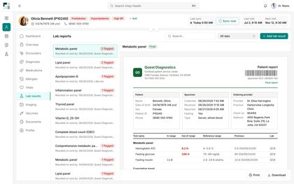
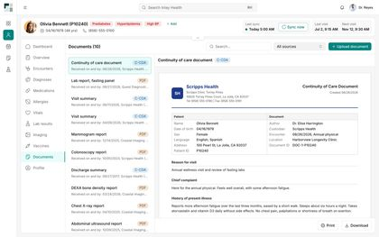
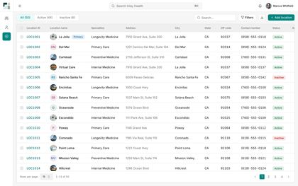
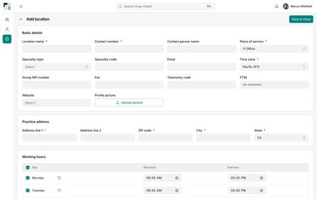
Three portals, one record
Inlay sets up the practice, the clinic manager runs it, and the provider works from one patient record.
01
02
03
SUPER ADMIN
CLINIC MANAGER
PROVIDER
Sign In and Security · Practices
Onboarding · Users · Patients · Locations
Onboarding and Patients · Record States · Patient Chart
›
›
INLAY HEALTH · CARE TEAM PORTALS
OVERVIEW
2

Slide 3
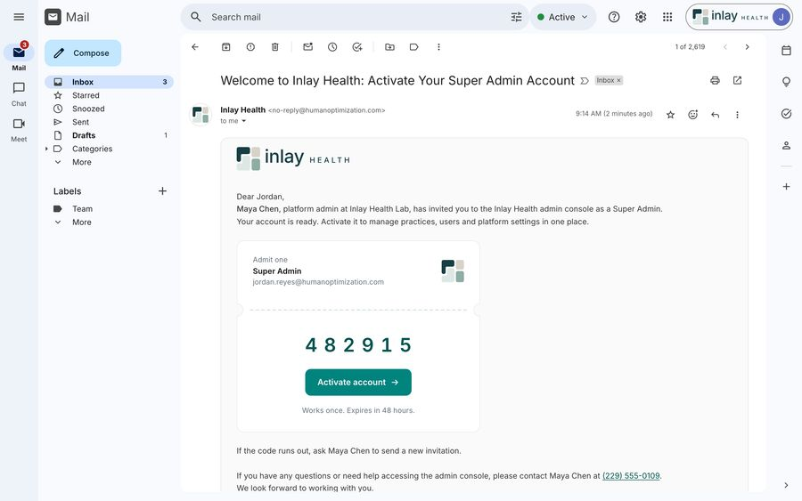
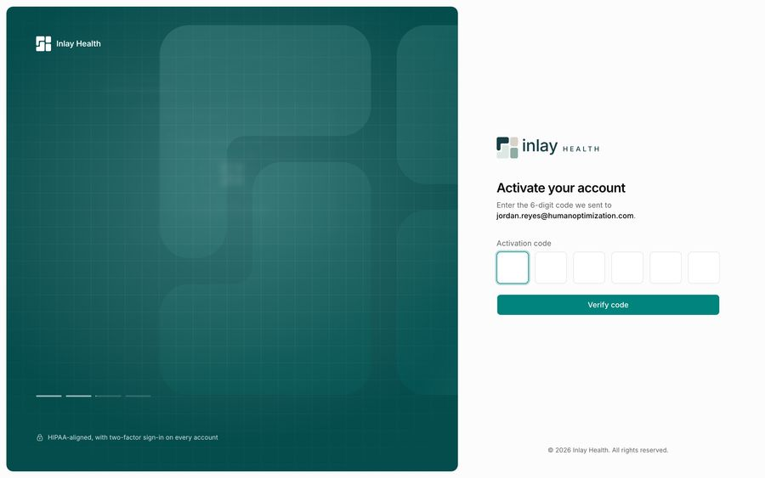
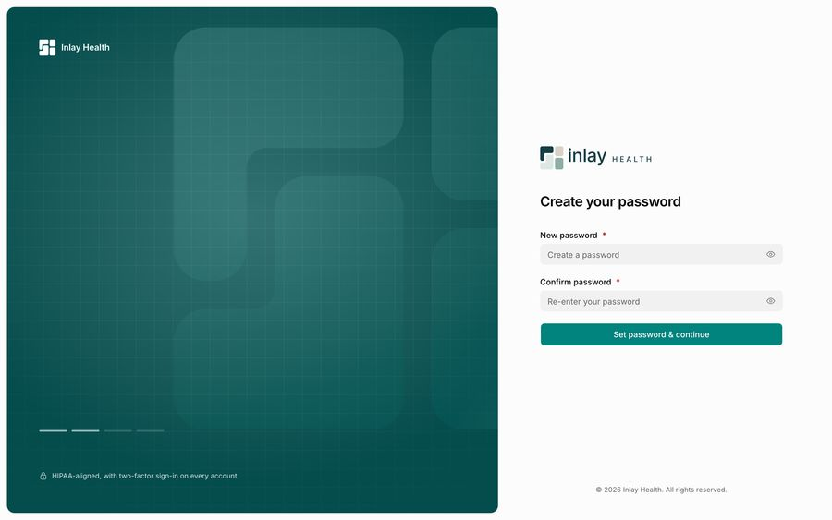
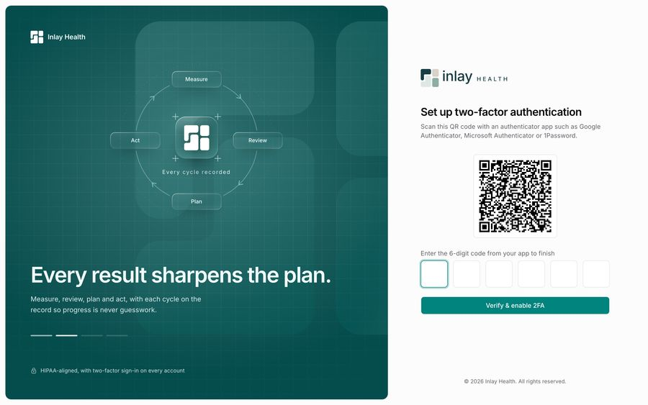
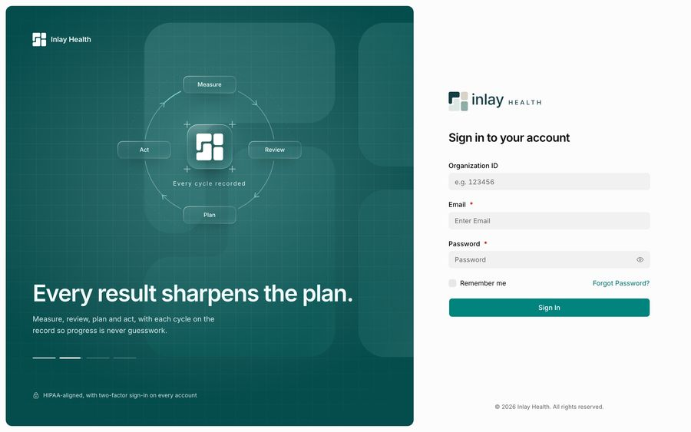

SUPER ADMIN · STAGE 01
Sign In and Security
1 Invitation Email
2 Activate Account
Six screens, shown once for all three portals. Every account starts from an invitation and ends with two-factor sign-in. Nobody self-registers.
Screens 1 to 6
3 Create Password
4 Two-Factor Set-Up
5 Sign In
6 Two-Factor Verification

Slide 4
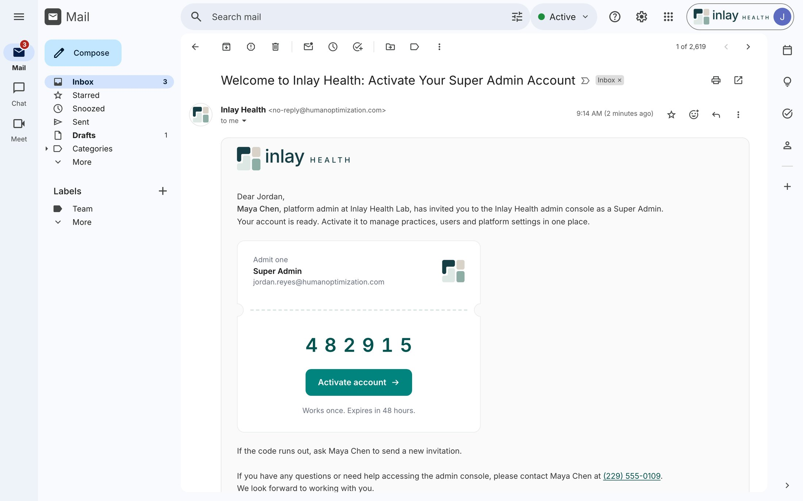
01
SUPER ADMIN · SIGN IN AND SECURITY
Invitation Email
The invitation is the account
Accounts are never self-created. Maya Chen, a platform admin, invites Jordan Reyes as a Super Admin, and the email carries everything needed to get in.
A ticket-style card names the role, Super Admin, and the address it belongs to before any code appears
Code 482915 sits above a single Activate account button, so there is one way forward
"Works once. Expires in 48 hours." A named person to ask for a new one, never a generic help desk
INLAY HEALTH · CARE TEAM PORTALS
SCREEN 1 OF 38
4

Slide 5

02
SUPER ADMIN · SIGN IN AND SECURITY
Activate Account
Prove the inbox first
The first portal screen asks for one thing: the 6-digit code that was emailed. The address is shown in full, so the invitee knows which inbox to check.
Six single-digit boxes and one Verify code button; nothing else competes on the panel
jordan.reyes@humanoptimization.com is printed under the heading, so a wrong account is caught here
The brand panel states the rule early: HIPAA-aligned, with two-factor sign-in on every account
INLAY HEALTH · CARE TEAM PORTALS
SCREEN 2 OF 38
5

Slide 6

03
SUPER ADMIN · SIGN IN AND SECURITY
Create Password
Two fields, one button
Password creation is kept to the minimum: new password, confirm, continue. Both fields are required and both can be revealed.
New password and Confirm password, each marked required with a red asterisk
An eye icon on each field lets the user check what they typed instead of retyping it
"Set password & continue" signals that set-up is not finished yet
INLAY HEALTH · CARE TEAM PORTALS
SCREEN 3 OF 38
6

Slide 7
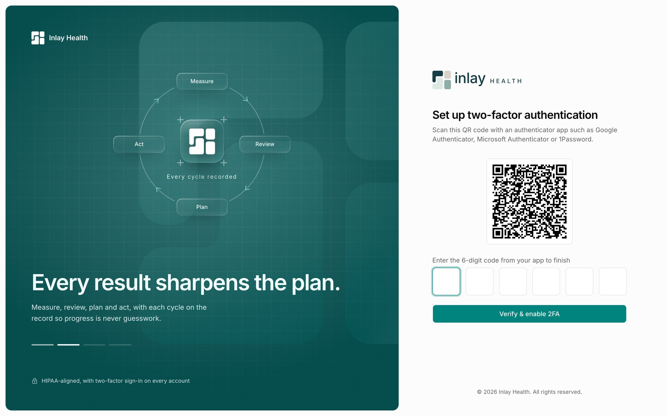
04
SUPER ADMIN · SIGN IN AND SECURITY
Two-Factor Set-Up
Security is not a setting
Two-factor is part of activation, not something to find later. The account cannot be used until an authenticator app is paired.
A QR code plus named apps: Google Authenticator, Microsoft Authenticator or 1Password
"Verify & enable 2FA" completes only with a live 6-digit code from the app
The brand panel shows the product loop for the first time: Measure, Review, Plan, Act
INLAY HEALTH · CARE TEAM PORTALS
SCREEN 4 OF 38
7

Slide 8
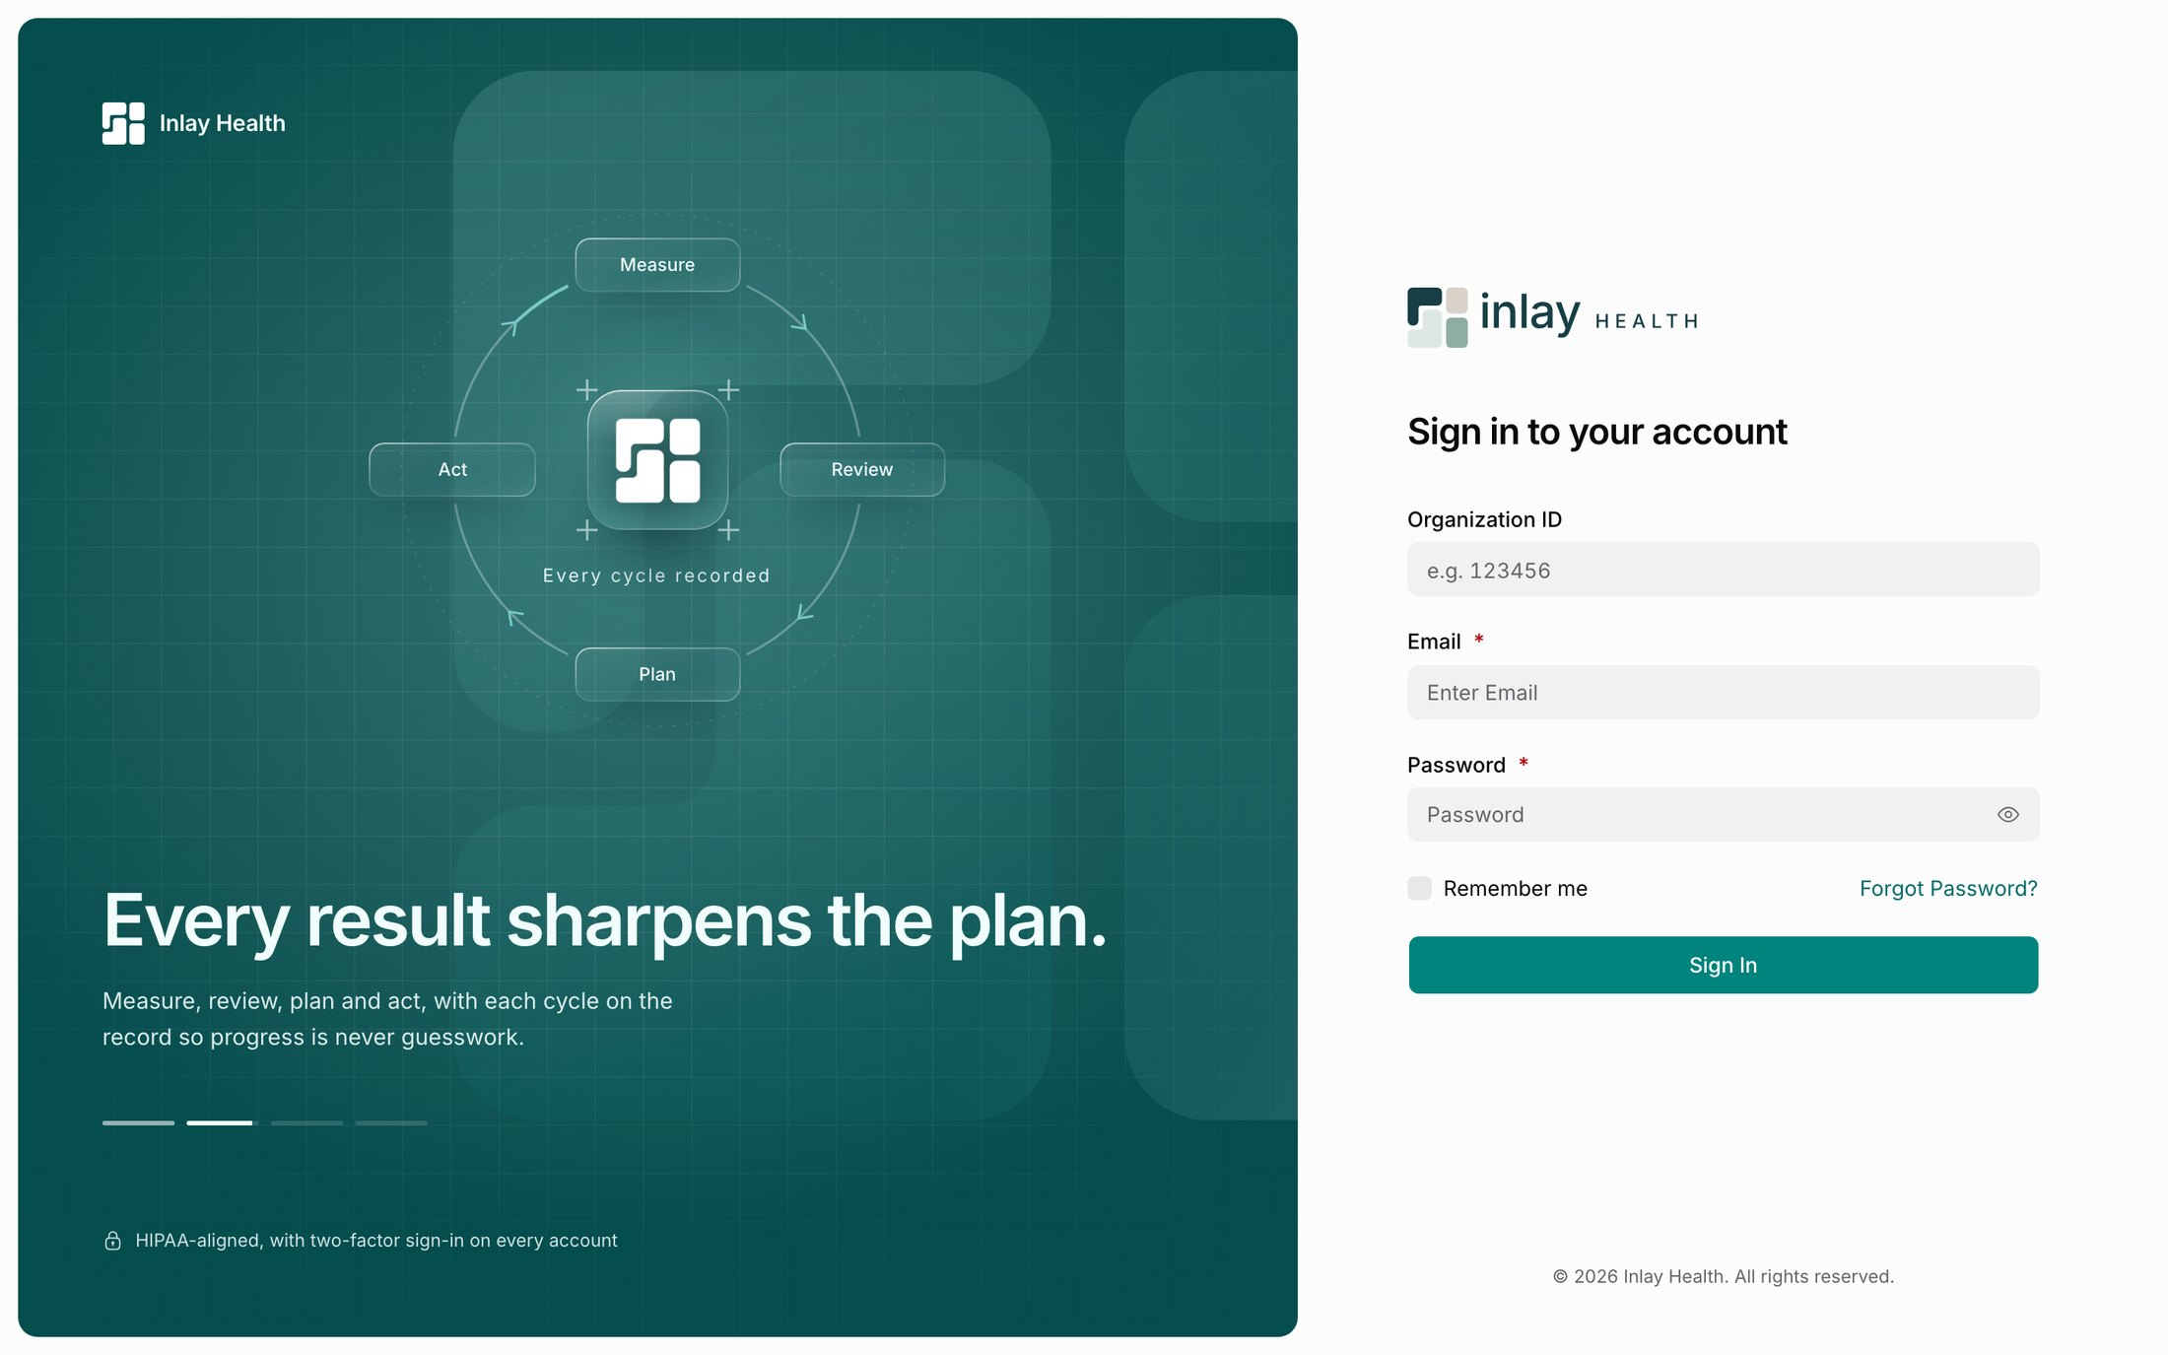
05
SUPER ADMIN · SIGN IN AND SECURITY
Sign In
One door for every role
Super Admin, clinic manager and provider all sign in here. Each person is routed by their account, so there is no role picker to get wrong.
Organization ID, Email and Password, with an e.g. 123456 hint for the ID
Remember me and Forgot Password? share one line under the fields, out of the main path
One Sign In button. The same screen serves all three portals, which is why it appears once here
INLAY HEALTH · CARE TEAM PORTALS
SCREEN 5 OF 38
8

Slide 9

06
SUPER ADMIN · SIGN IN AND SECURITY
Two-Factor Verification
Every sign-in, every time
After the password comes a fresh code from the authenticator app. It is the second half of every sign-in, not only the first.
Authentication code in six boxes, then Verify
"Back to sign in" is the only other action, for the user who picked the wrong account
The same layout as activation, so returning users meet nothing new
INLAY HEALTH · CARE TEAM PORTALS
SCREEN 6 OF 38
9

Slide 10
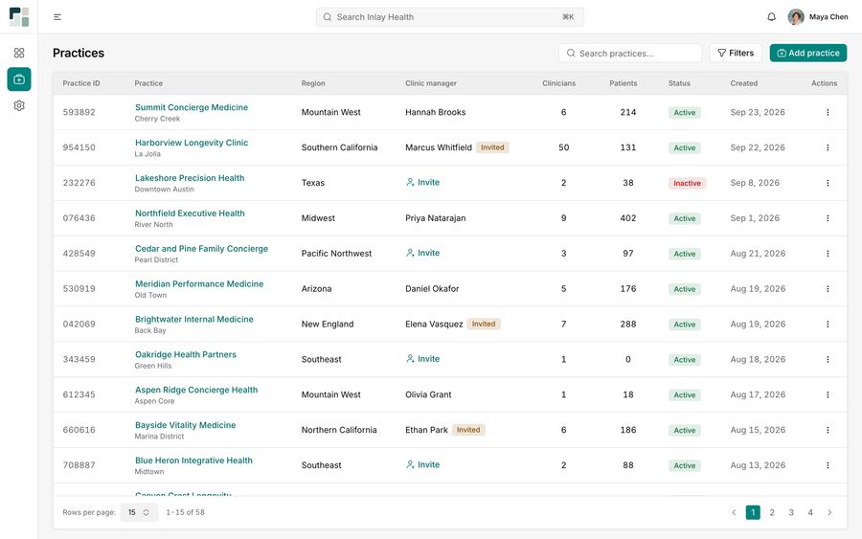
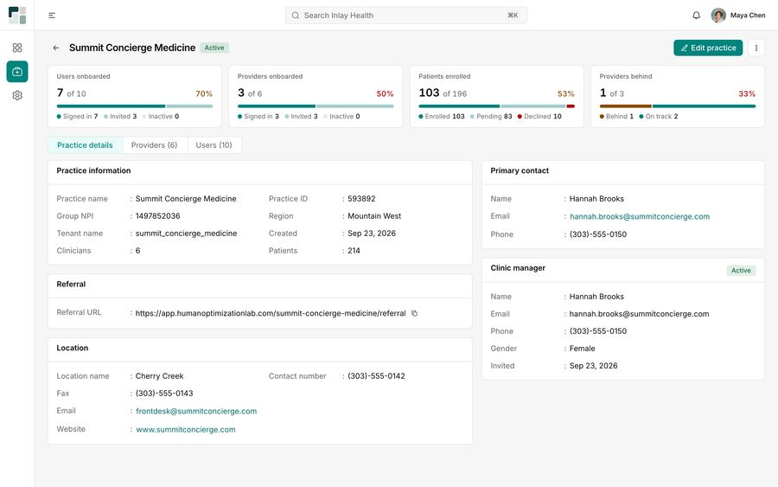
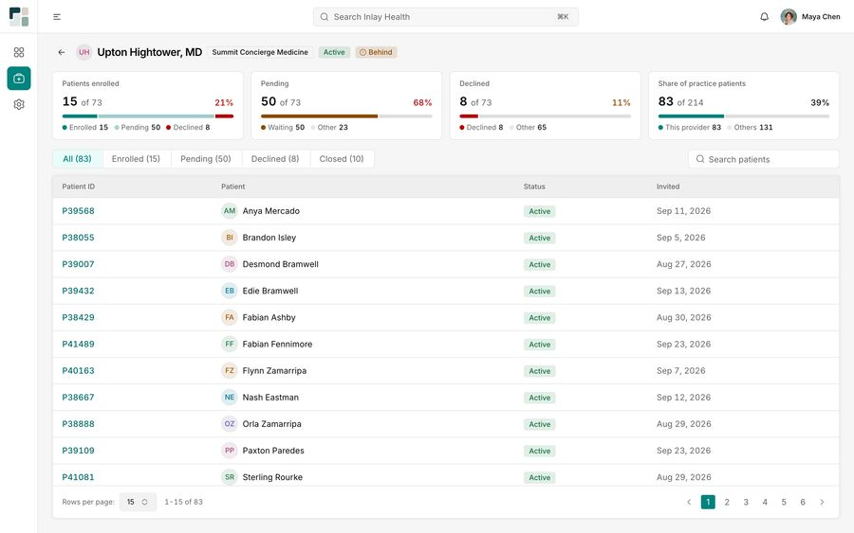
SUPER ADMIN · STAGE 02
Practices
The Super Admin creates practices, invites each clinic manager and watches adoption, from the whole practice down to a single provider.
7 Practices
8 Practice Details
Screens 7 to 9
9 Provider Adoption

Slide 11

07
SUPER ADMIN · PRACTICES
Practices
Every practice on one page
The Super Admin's home is the list of practices. Each row answers three questions: who runs it, how big it is, and whether it is live.
58 practices, 15 a page, with region, clinician and patient counts on every row
The Clinic manager column shows the gap: an Invite link where none exists, an Invited tag until they activate
Add practice is the only primary button; search and Filters sit beside it
INLAY HEALTH · CARE TEAM PORTALS
SCREEN 7 OF 38
11

Slide 12
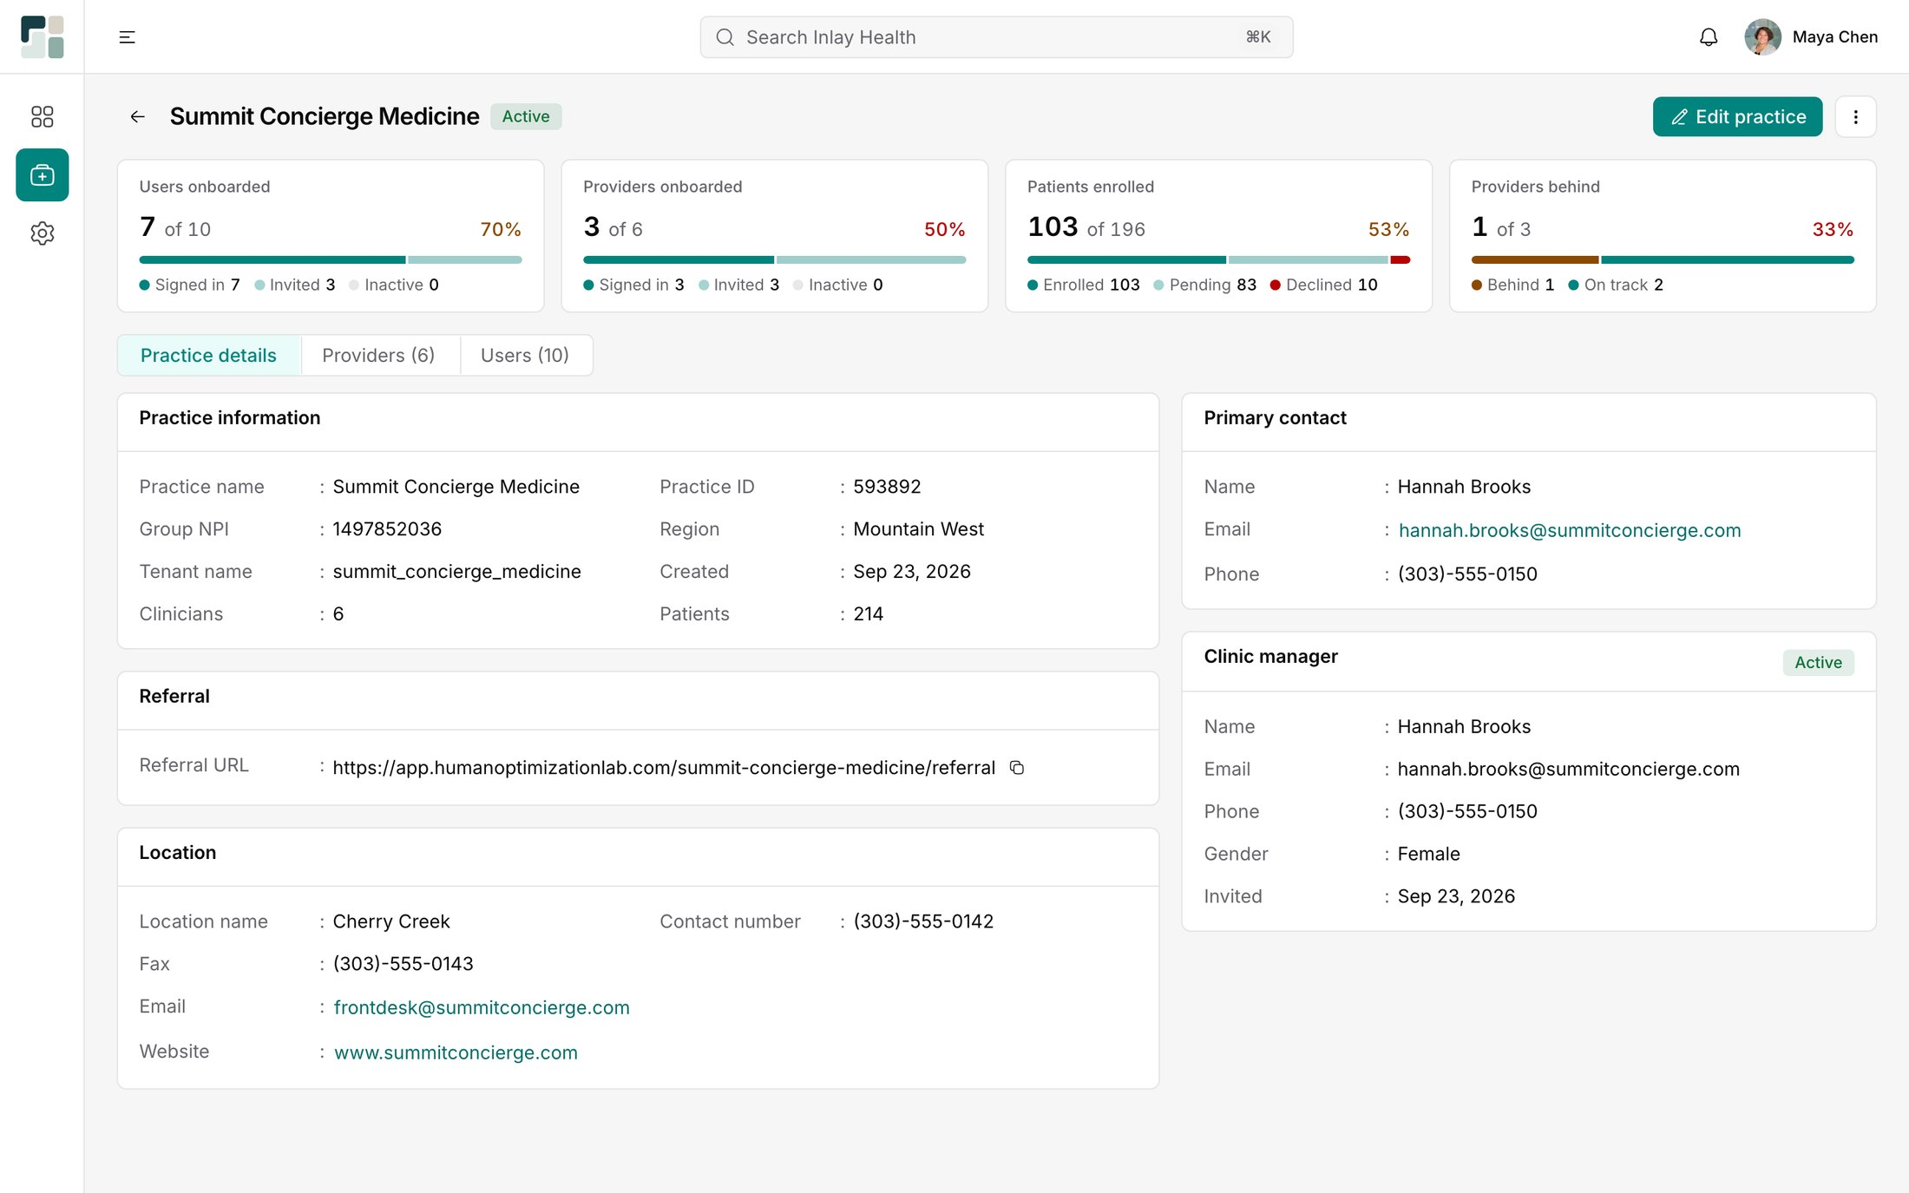
08
SUPER ADMIN · PRACTICES
Practice Details
Adoption before admin
A practice opens on four adoption meters, then the record. The first question a Super Admin asks is whether the practice is actually using Inlay.
Users 7 of 10, providers 3 of 6, patients enrolled 103 of 196 (53%), providers behind 1 of 3
Practice, referral, location and clinic manager in Label : Value blocks, with a copyable referral URL
Providers (6) and Users (10) tabs keep the people one click away
INLAY HEALTH · CARE TEAM PORTALS
SCREEN 8 OF 38
12

Slide 13

09
SUPER ADMIN · PRACTICES
Provider Adoption
Who is behind, and by how much
Drilling into a provider shows their enrolment funnel. Upton Hightower, MD is tagged Behind, and the four meters say why.
15 of 73 enrolled (21%), 50 pending (68%), 8 declined (11%)
He holds 83 of the practice's 214 patients (39%), so his gap is the practice's gap
Tabs All (83), Enrolled (15), Pending (50), Declined (8) and Closed (10) filter the list below
INLAY HEALTH · CARE TEAM PORTALS
SCREEN 9 OF 38
13

Slide 14

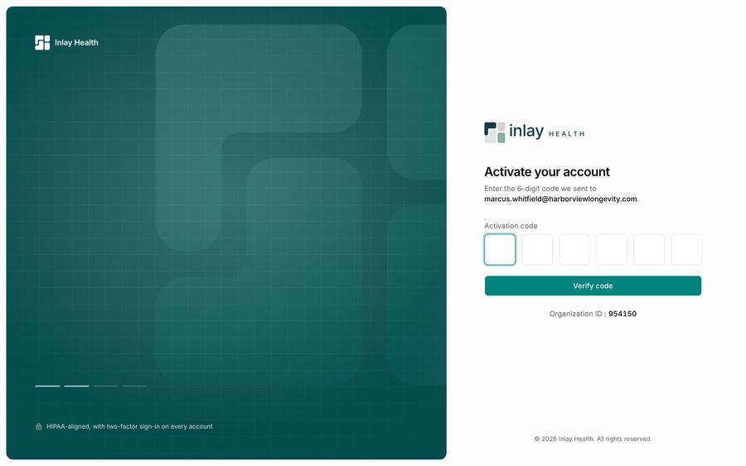
CLINIC MANAGER · STAGE 03
Onboarding
The clinic manager arrives the same way: an invitation from the Super Admin, then the shared activation, password and two-factor screens.
10 Clinic Manager Invitation
Screens 10 to 11
11 Clinic Manager Activation

Slide 15

10
CLINIC MANAGER · ONBOARDING
Clinic Manager Invitation
Invited with the practice attached
The clinic manager's email names the practice they are joining. Marcus Whitfield is invited to run Harborview Longevity Clinic by the Super Admin who created it.
The ticket reads Clinic Manager, marcus.whitfield@harborviewlongevity.com
The body says what the role is for: clinicians, patients and settings in one place
Same code, same 48-hour expiry, same layout as every other invitation
INLAY HEALTH · CARE TEAM PORTALS
SCREEN 10 OF 38
15

Slide 16

11
CLINIC MANAGER · ONBOARDING
Clinic Manager Activation
The organization ID, handed over
Activation for a practice account adds one line the Super Admin never needed: the Organization ID the clinic manager will sign in with.
Organization ID : 954150 sits under Verify code and matches the practice ID on the Super Admin list
The address shown is on the practice domain, confirming the right account
Password and two-factor follow exactly as in the Super Admin flow, so they are not repeated
INLAY HEALTH · CARE TEAM PORTALS
SCREEN 11 OF 38
16

Slide 17
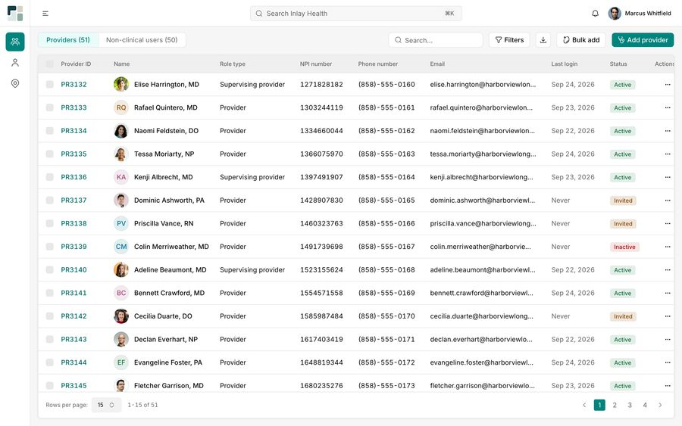

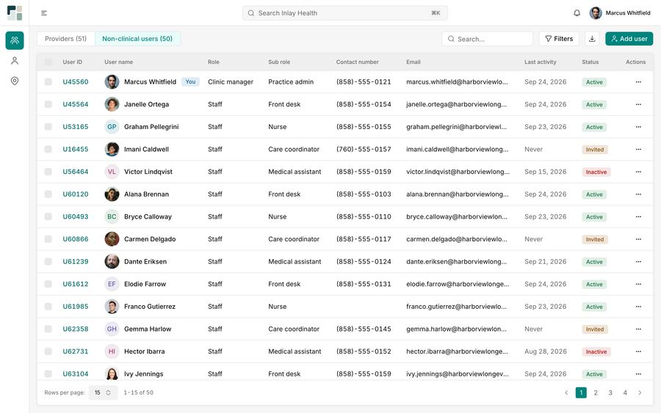
CLINIC MANAGER · STAGE 04
Users
Providers and non-clinical staff share one Users area with two tabs. The clinic manager adds, invites and maintains them.
12 Providers
13 Provider Details
Screens 12 to 14
14 Non-Clinical Users

Slide 18

12
CLINIC MANAGER · USERS
Providers
Fifty-one providers, one table
Providers open the clinic manager's portal. Every row carries what an administrator checks: role, NPI, contact and whether the person has ever signed in.
Providers (51) and Non-clinical users (50) as tabs, so both groups share one screen
Last login "Never" beside an Invited tag shows at once who has not activated
Bulk add next to Add provider, for a practice onboarding many clinicians at once
INLAY HEALTH · CARE TEAM PORTALS
SCREEN 12 OF 38
18

Slide 19

13
CLINIC MANAGER · USERS
Provider Details
A profile, not a form
A provider's page reads like a profile card. Elise Harrington's credentials, contact details and role are grouped into labelled sections.
PR3132, MD, NPI 1271828182 and taxonomy 207R00000X Internal Medicine in the first block
SSN masked to ***-**-1842; empty fields read "Not provided" in grey rather than sitting blank
Role: Supervising provider, with Add signature waiting in its own card
INLAY HEALTH · CARE TEAM PORTALS
SCREEN 13 OF 38
19

Slide 20
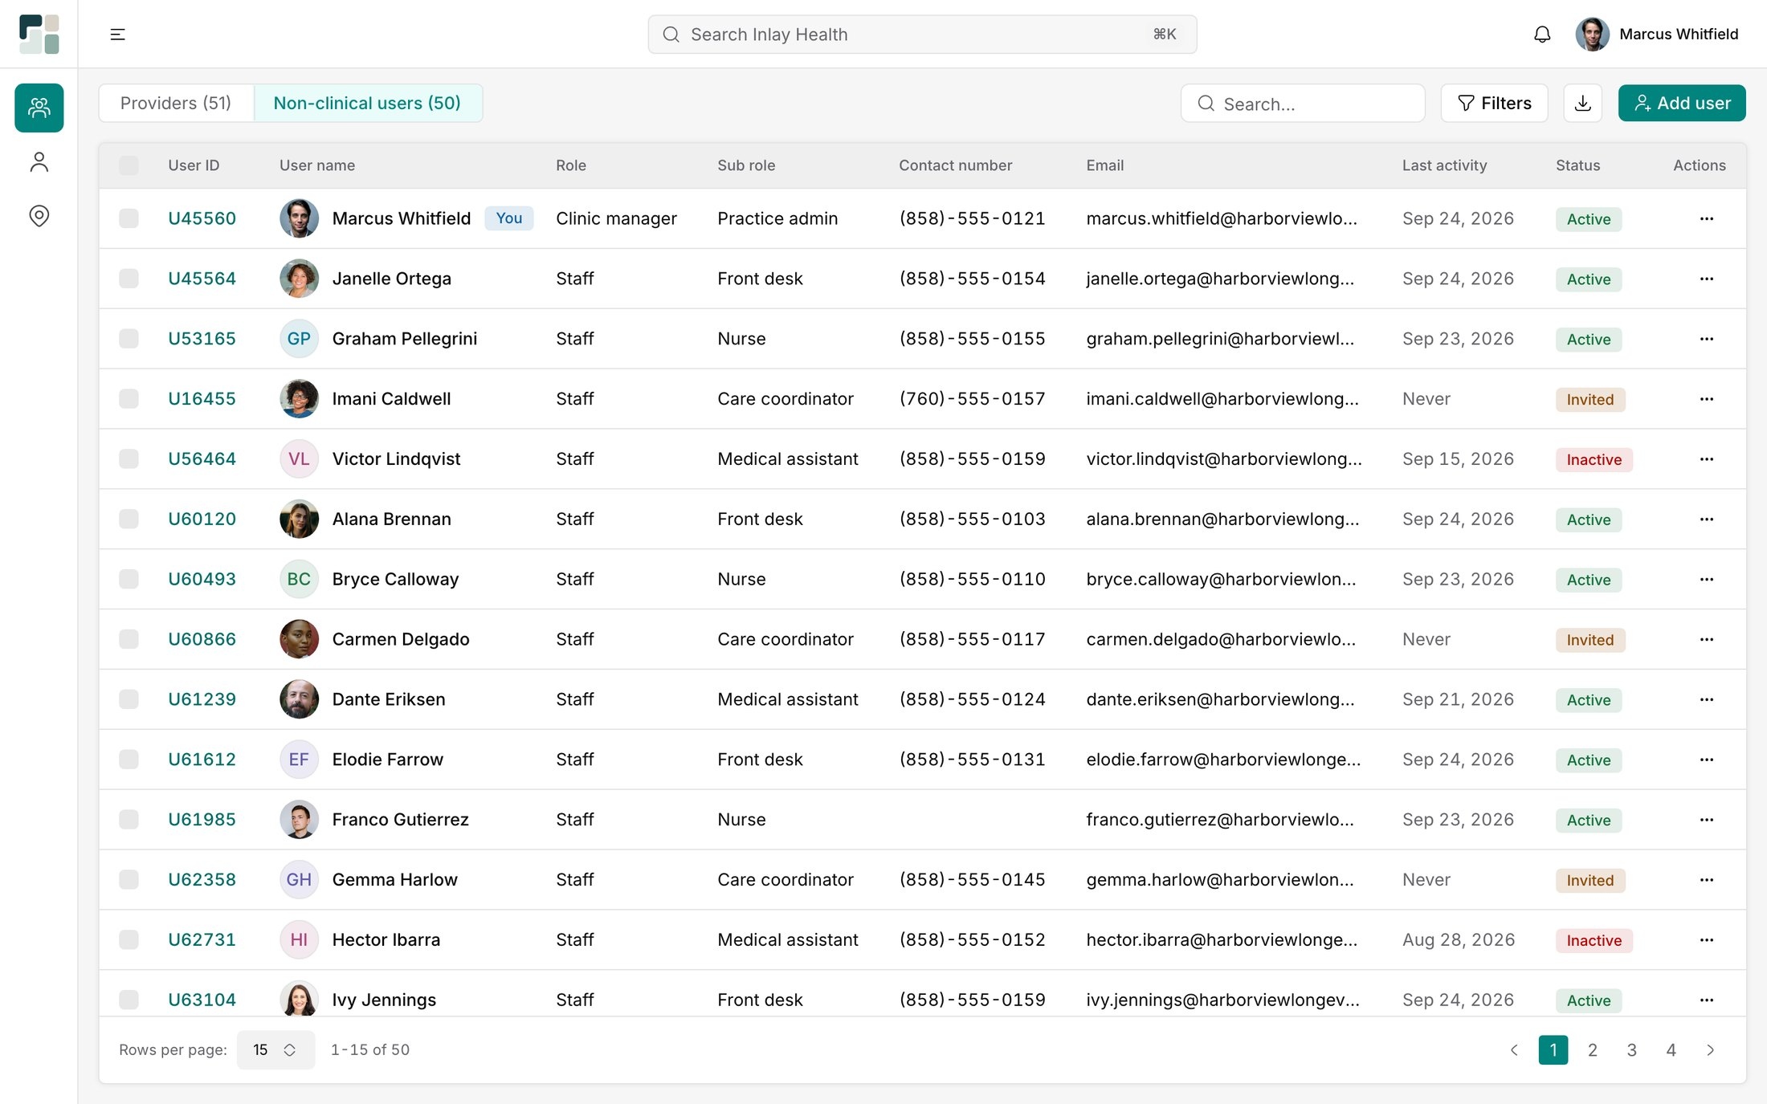
14
CLINIC MANAGER · USERS
Non-Clinical Users
Staff, by what they actually do
The second tab lists the people who keep the practice running. Role is Staff; the sub role says what each person does.
Front desk, Nurse, Care coordinator and Medical assistant as sub roles
Marcus Whitfield is tagged You: Clinic manager, sub role Practice admin
Active, Invited and Inactive tags beside Last activity show who really uses the portal
INLAY HEALTH · CARE TEAM PORTALS
SCREEN 14 OF 38
20

Slide 21





CLINIC MANAGER · STAGE 05
Patients
15 Patients
16 Add Patient
The clinic manager adds and maintains patients and resolves possible duplicates. They see demographics and enrolment, never the medical record.
Screens 15 to 19
17 Patient Details
18 Possible Duplicates
19 Duplicate Review

Slide 22

15
CLINIC MANAGER · PATIENTS
Patients
Duplicates surface first
The patient list opens with a banner, not the table. Possible duplicates are the one job only the clinic manager can do, so they come first.
"3 possible duplicates need review" with a single Review button above the list
All (131), Active (80) and Inactive (51); statuses include Discharged as well as Active
Location and Primary provider on every row; no clinical columns appear in this portal
INLAY HEALTH · CARE TEAM PORTALS
SCREEN 15 OF 38
22

Slide 23

16
CLINIC MANAGER · PATIENTS
Add Patient
Six fields before the full form
Adding a patient starts with a short dialog. The identifying details come first, so a match can be caught before anyone fills in a full profile.
First name, Last name, Date of birth and Sex at birth are required; Email and Mobile number complete the match
Cancel and Continue are the only actions
The full form waits behind the dialog, sectioned into basic details, additional details and care team
INLAY HEALTH · CARE TEAM PORTALS
SCREEN 16 OF 38
23

Slide 24

17
CLINIC MANAGER · PATIENTS
Patient Details
Demographics, not diagnoses
The clinic manager's view of a patient stops at the profile. Olivia Bennett's contact details, care team and enrolment are here; her health record is not.
Care team names the location, La Jolla, and the primary provider, Elise Harrington, MD
The Enrollment card reads Invite: Accepted, Invited: Aug 25, 2026
Unknown fields read Not provided, so a gap is visible rather than hidden
INLAY HEALTH · CARE TEAM PORTALS
SCREEN 17 OF 38
24

Slide 25

18
CLINIC MANAGER · PATIENTS
Possible Duplicates
Why each pair was flagged
Each row pairs an incoming patient with the existing record it resembles, and says what matched. Nothing is merged automatically.
Matched on names the evidence: name and date of birth, date of birth and email, name and mobile number
Source shows Bulk import or Manual; Sent by shows whether a provider or the clinic manager added it
Three in the queue, each with one Review button
INLAY HEALTH · CARE TEAM PORTALS
SCREEN 18 OF 38
25

Slide 26

19
CLINIC MANAGER · PATIENTS
Duplicate Review
Compare, then resolve
The review puts both records side by side, field by field. Matches and differences are tinted, so the decision takes seconds.
Name, date of birth, sex, location and primary provider Match; email, mobile and address Differ
Existing record P10291, Active, against an incoming Bulk import record
One Resolve button, with the trail kept: Sent by Marcus Whitfield on Oct 8, 2026
INLAY HEALTH · CARE TEAM PORTALS
SCREEN 19 OF 38
26

Slide 27



CLINIC MANAGER · STAGE 06
Locations
Every site the practice runs, with its identifiers, address and working hours. Locations feed the provider and patient forms.
20 Locations
21 Add Location
Screens 20 to 22
22 Location Details

Slide 28

20
CLINIC MANAGER · LOCATIONS
Locations
Fifty sites, the primary marked
The locations list gives each site an ID, specialty, address and contact line. The primary location is tagged so it is never confused with the rest.
All (50), Active (44) and Inactive (6)
La Jolla carries a Primary tag; Virtual Care is listed as a location of its own
Specialties such as Longevity Medicine, Primary Care and Preventive Medicine on every row
INLAY HEALTH · CARE TEAM PORTALS
SCREEN 20 OF 38
28

Slide 29

21
CLINIC MANAGER · LOCATIONS
Add Location
Identifiers once, defaults everywhere
The location form is split into basic details, practice address and working hours. Common values are pre-set, so most locations need little typing.
Place of service defaults to 11 Office, time zone to Pacific (PT), state to CA
Group NPI, taxonomy code and FTIN are captured once for the whole site
Working hours start at 08:00 AM to 05:00 PM, with a copy icon to repeat a day
INLAY HEALTH · CARE TEAM PORTALS
SCREEN 21 OF 38
29

Slide 30

22
CLINIC MANAGER · LOCATIONS
Location Details
One site, one page
The location page mirrors the form in read mode. Everything a front desk or biller needs about La Jolla is on one screen.
LOC1001, place of service 11 Office, specialty Longevity Medicine 2083P0500X
Providers: 5, linking the site to the people who work there
Working hours as a week strip: Monday to Friday 08:00 AM to 05:00 PM, weekends Closed
INLAY HEALTH · CARE TEAM PORTALS
SCREEN 22 OF 38
30

Slide 31


PROVIDER · STAGE 07
Onboarding and Patients
23 Provider Invitation
The provider is invited by their clinic manager, signs in through the shared screens and lands on their patient list.
Screens 23 to 24
24 Provider Patient List

Slide 32

23
PROVIDER · ONBOARDING AND PATIENTS
Provider Invitation
Invited to add patients
The provider's invitation comes from their own clinic manager. It states the job in one line: add your patients and invite them to the Inlay Health app.
Marcus Whitfield, clinic manager at Harborview Longevity Clinic, is named as the sender
The ticket reads Provider, elise.harrington@harborviewlongevity.com
A new invitation is requested from Marcus, the person who sent this one
INLAY HEALTH · CARE TEAM PORTALS
SCREEN 23 OF 38
32

Slide 33

24
PROVIDER · ONBOARDING AND PATIENTS
Provider Patient List
Record status on every row
The provider's patient list adds what the clinic manager's leaves out: the state of each health record and when it last synced.
Health record column: Synced, Waiting for consent, Record building, Sync failed
Last sync reads Today, 5:00 AM or Yesterday, 5:00 AM, so a stale record stands out
Add patient and Bulk add sit here too; adding a patient sends the invitation at once
INLAY HEALTH · CARE TEAM PORTALS
SCREEN 24 OF 38
33

Slide 34



PROVIDER · STAGE 08
Record States
Before consent, during the first sync and after a failure, the chart says exactly what is happening and what the provider can do.
25 Waiting for Consent
26 Building the Record
Screens 25 to 27
27 Sync Failed

Slide 35

25
PROVIDER · RECORD STATES
Waiting for Consent
Empty, and honest about it
Until the patient consents in the app, there is no record to show. The chart says so plainly instead of showing empty tables.
Last sync: Waiting for consent, with Sync now greyed out
"No record yet" says the chart fills in once Harrison consents and the EHR returns the record
The full chart navigation stays visible, so the provider learns the layout before data arrives
INLAY HEALTH · CARE TEAM PORTALS
SCREEN 25 OF 38
35

Slide 36

26
PROVIDER · RECORD STATES
Building the Record
Results arrive as they report
Once consent is given, the record is collected from the connected sources. The provider sees what is happening, not a spinner.
"Building the record": the EHR connection is still collecting, and results appear as each source reports in
Sync now in both the banner and the empty state, for a provider who wants to check again
Last sync Today 5:00 AM shows the connection is live
INLAY HEALTH · CARE TEAM PORTALS
SCREEN 26 OF 38
36

Slide 37

27
PROVIDER · RECORD STATES
Sync Failed
The failure, with a reason
When a sync fails, the chart names the source and the likely cause. The provider can fix it or retry, rather than guess.
"Scripps Health (Epic) returned no documents for this patient"
The likely cause is stated: the name or date of birth may not match the hospital's record
Retry sync appears twice: in red in the banner and again under the message
INLAY HEALTH · CARE TEAM PORTALS
SCREEN 27 OF 38
37

Slide 38











28 Dashboard: Free Member
29 Dashboard: Optimization Member
30 Face Sheet
PROVIDER · STAGE 09
Patient Chart
Eleven screens from one chart. The dashboard says what changed since the last review; the sections behind it hold the full record, source by source.
31 Timeline
32 Encounters
33 Diagnoses
Screens 28 to 38
34 Medications
35 Vitals
36 Lab Results
37 Imaging
38 Documents

Slide 39

28
PROVIDER · PATIENT CHART
Dashboard: Free Member
What changed since you last looked
The dashboard opens on change, not on everything. For Olivia Bennett, a free member, an ED visit leads with the four changes it brought. Recommend optimization sits one click away.
ED visit banner: potassium 4.4 → 5.8, atorvastatin 10 mg → 20 mg, metoprolol not on your list
Important updates 9: Action needed 5 and For review 4, new since 07/02/2026
A side panel opens on the top item, with Mark reviewed, Open encounters and Open documents
INLAY HEALTH · CARE TEAM PORTALS
SCREEN 28 OF 38
39

Slide 40

29
PROVIDER · PATIENT CHART
Dashboard: Optimization Member
Same dashboard, a member's priorities
An Optimization member gets the same dashboard, led by whatever is moving. For Marcus Hale it opens on declining kidney function.
eGFR 67 → 62, lisinopril doubled, renal ultrasound 18 days overdue, urine ACR never tested
Side panel: current eGFR 62 against a range of ≥ 60, down 7%, with an eight-result trend
Actions fit the finding: View full trend, Order Urine ACR, Add to care plan, Mark reviewed
INLAY HEALTH · CARE TEAM PORTALS
SCREEN 29 OF 38
40

Slide 41

30
PROVIDER · PATIENT CHART
Face Sheet
The whole record on one page
The face sheet gives each part of the record a card, three columns wide. Every card shows the latest entries and a View all.
Allergies with severity: penicillin Moderate, shellfish Severe, pollen Mild
Lab results count flags inline: metabolic panel, 3 tests, 2 flagged
A grip on every card lets each provider rearrange the sheet; Print chart sits top right
INLAY HEALTH · CARE TEAM PORTALS
SCREEN 30 OF 38
41

Slide 42

31
PROVIDER · PATIENT CHART
Timeline
Every event, in date order
The timeline lays the record out by day, newest first. Vaccines, documents, encounters and results run in one stream.
08/26/2026 holds 11 events: an annual physical, a lab draw and the results that followed
Each card names its type, status and source, such as Encounter: Completed or Lab result: Final
An All filter at the top narrows the stream to one kind of event
INLAY HEALTH · CARE TEAM PORTALS
SCREEN 31 OF 38
42

Slide 43

32
PROVIDER · PATIENT CHART
Encounters
The note, as it was written
Encounters list on the left; the selected visit opens as the actual progress note, letterhead and all.
Encounters (7), each tagged In person, Lab, Virtual or Imaging
The annual physical note shows reason for visit, chief complaint and history of present illness
An All sources filter above, Print and Download below the paper
INLAY HEALTH · CARE TEAM PORTALS
SCREEN 32 OF 38
43

Slide 44

33
PROVIDER · PATIENT CHART
Diagnoses
Active above historical
Each diagnosis carries its ICD-10 code, type and dates, with a short note on why it matters now.
R73.03 Prediabetes, E78.5 Hyperlipidemia and R03.0 Elevated blood pressure reading are Active
Resolved conditions stay as Historical with an end date, such as gestational diabetes in 2006
Add diagnosis for practice entries, beside source and status filters
INLAY HEALTH · CARE TEAM PORTALS
SCREEN 33 OF 38
44

Slide 45

34
PROVIDER · PATIENT CHART
Medications
Read like a prescription
Each medication shows what, how, how much and who wrote it. Active and past lists sit on separate tabs.
Active medications (3) and Past medications (1)
Atorvastatin 10 mg tablet: take 1 tablet by mouth at bedtime, 30 tablets, Dr. Elise Harrington
An RxNorm code on every row, such as 617312, for matching the same drug across sources
INLAY HEALTH · CARE TEAM PORTALS
SCREEN 34 OF 38
45

Slide 46

35
PROVIDER · PATIENT CHART
Vitals
Only the outliers are coloured
Each vital gets a card with the latest value, the previous one and a plain note. Only readings outside range are coloured.
Blood pressure 130/80 mmHg and BMI 26.6 in red, each noted Above normal
The previous value sits under each reading: 136/88 mmHg, 81 bpm, 75.3 kg
Card, Trend and Table views, with the LOINC code and who took each reading
INLAY HEALTH · CARE TEAM PORTALS
SCREEN 35 OF 38
46

Slide 47

36
PROVIDER · PATIENT CHART
Lab Results
The report, with flags counted
Lab reports list with their flag counts. The selected one opens as the lab's own patient report.
Metabolic panel, 2 flagged: hemoglobin A1C 6.1 H, fasting glucose 104 H
A Previous column gives the last value and date: 5.9 on 04/09/2026
Collection times, fasting status and ordering provider in the report header
INLAY HEALTH · CARE TEAM PORTALS
SCREEN 36 OF 38
47

Slide 48

37
PROVIDER · PATIENT CHART
Imaging
Radiology reports, read in place
Imaging studies open as the radiology report itself, on the imaging centre's letterhead: exam, history, technique and comparison.
Imaging (4): DEXA, screening mammogram, abdominal ultrasound and chest X-ray, all Final
The Exam block names CPT 77080, the referring clinic, the technologist and the reading physician
Add imaging result covers studies done outside the connected sources
INLAY HEALTH · CARE TEAM PORTALS
SCREEN 37 OF 38
48

Slide 49

38
PROVIDER · PATIENT CHART
Documents
Every file the record holds
Documents gathers every C-CDA and PDF received for the patient, newest first, each opening in place.
Documents (10), each tagged C-CDA or PDF with its source and date received
The Scripps Health continuity of care document opens with author, custodian and encounter
Upload document adds a practice file; Print and Download sit under every viewer
INLAY HEALTH · CARE TEAM PORTALS
SCREEN 38 OF 38
49

